Slide 1
Renal tumor imaging
Tarzamni, MD

Slide 2
Radiological assessment
Sonography
Multidetector CT scan, Ct angiography
MRI,
Angiography
PET scan

Slide 3
Sonography
US is considered a feasible first-imaging option for screening renal tumors.
The main advantages of US are the lack of ionizing radiation and no need for nephrotoxic contrast agents.
US is a relatively low-cost and easily available imaging modality, noninvasive and no specific preparations of the patient are necessary.

Slide 4
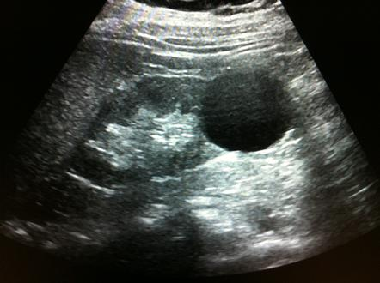
Cystic or solid

Slide 5
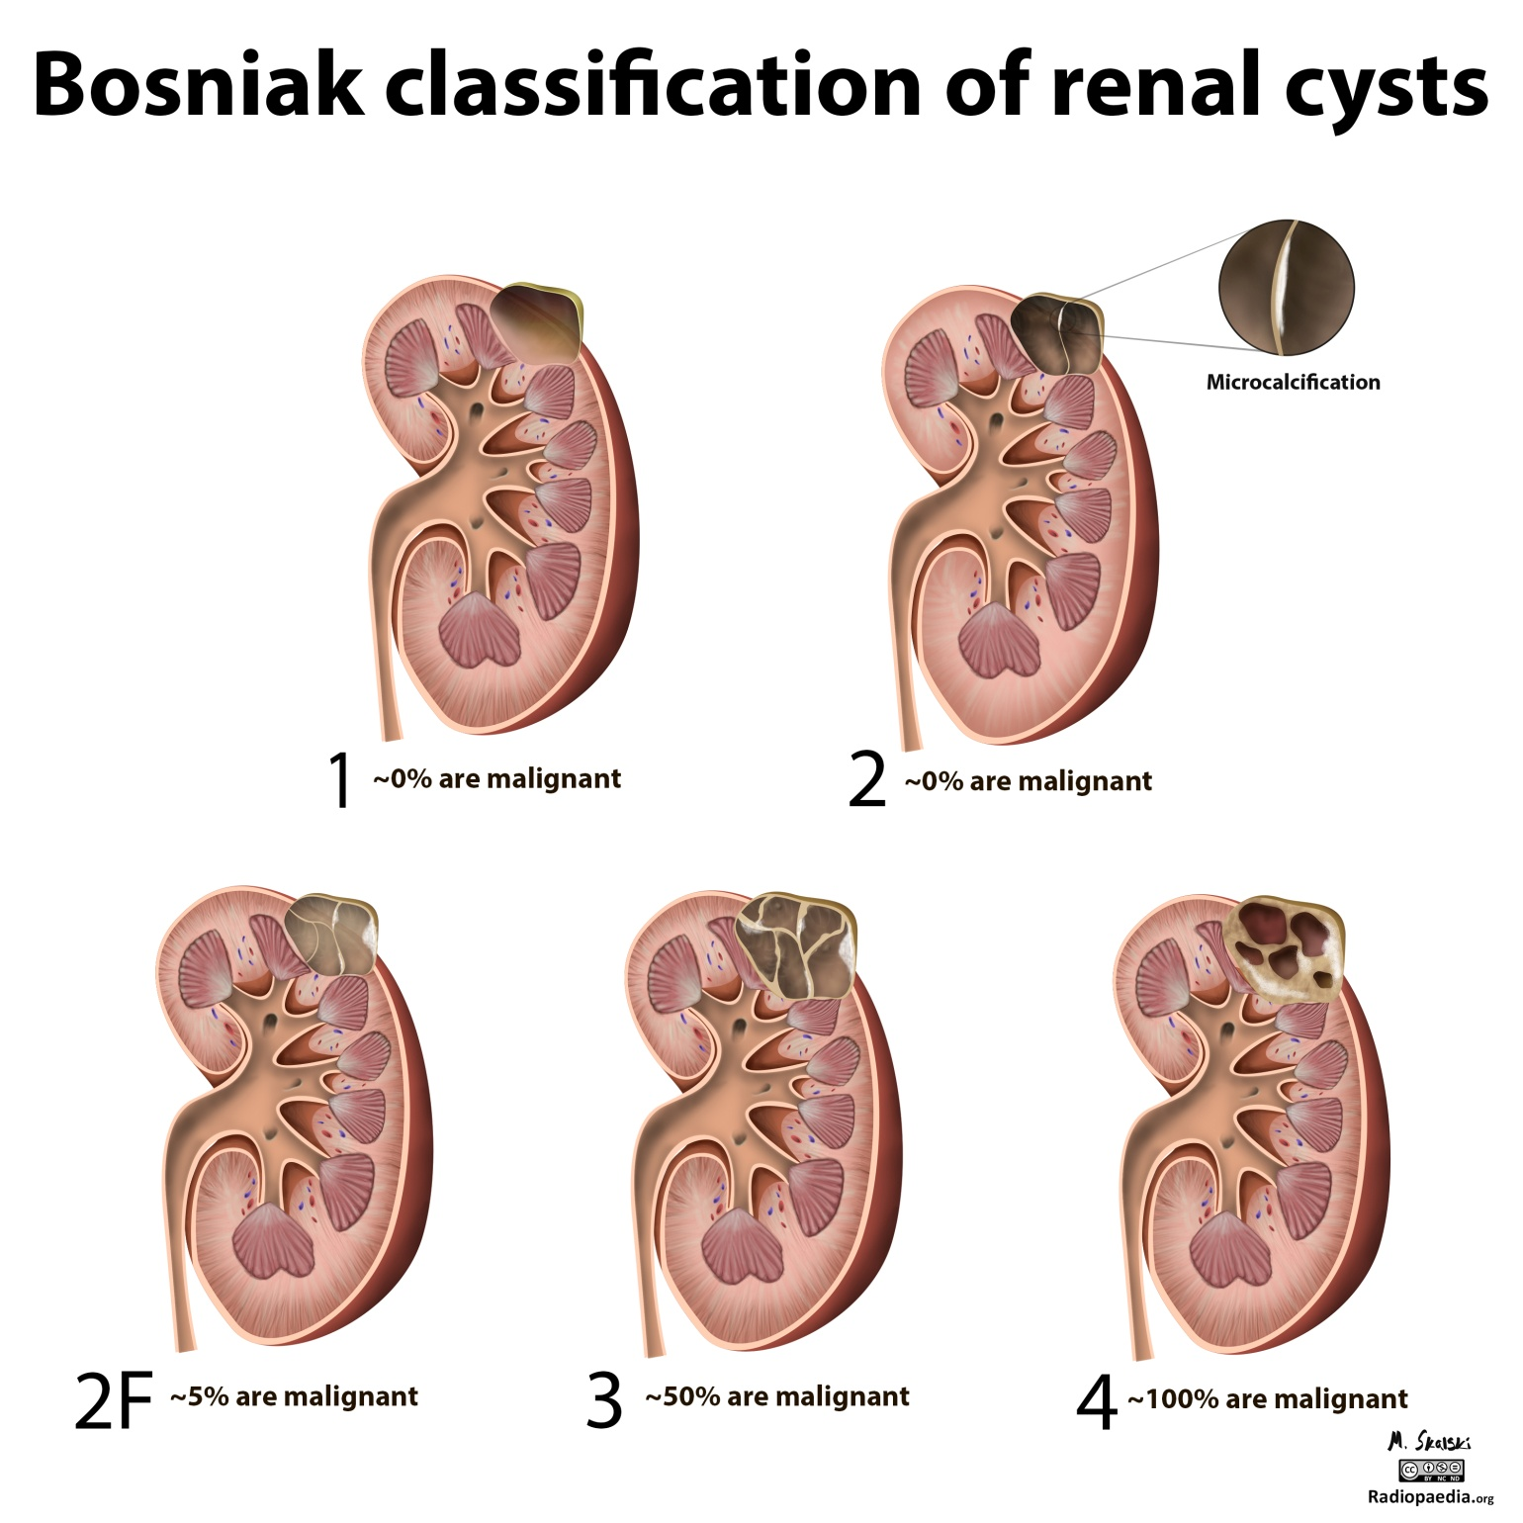

Slide 6
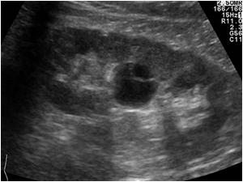
Bosniak 1
Bosniak 2

Slide 7
Bosniak 2F

Slide 8
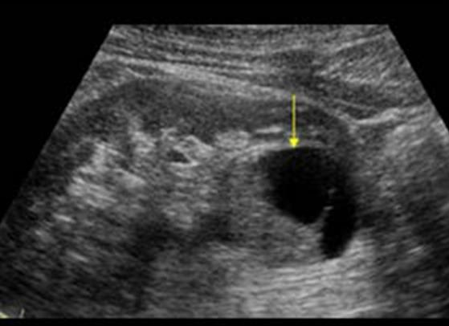
Bosniak 3
Bosniak 4

Slide 9
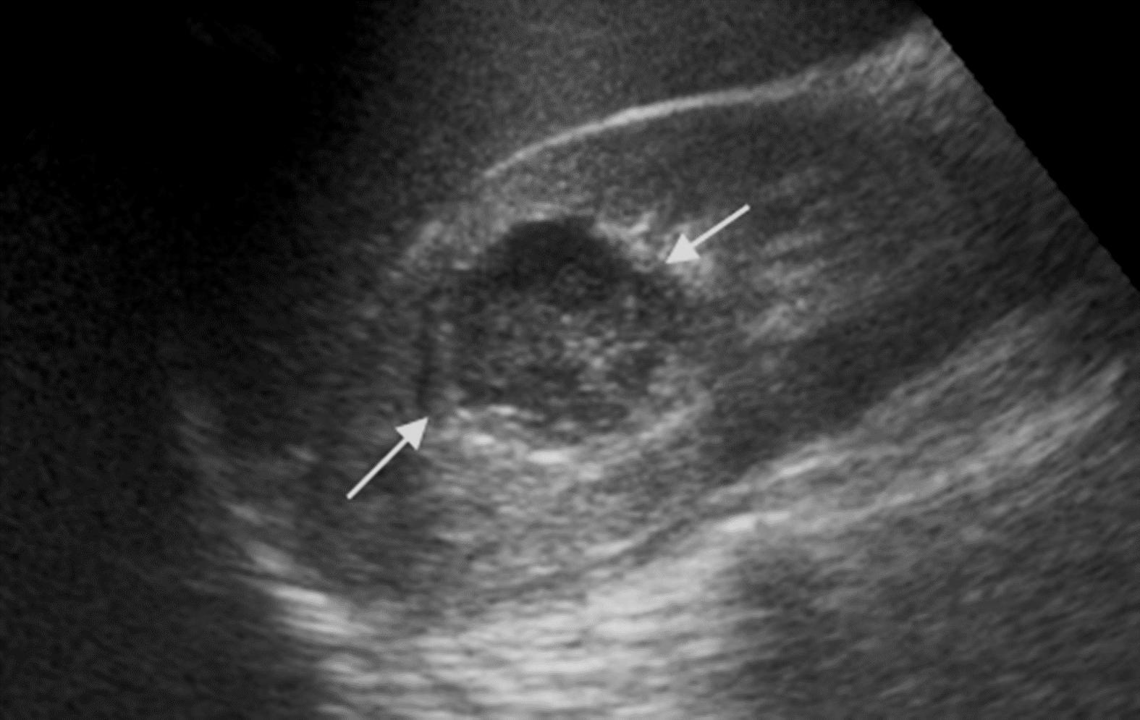
hemorrhagic cyst or complex cyst

Slide 10
Color Doppler

Slide 11
Color Doppler

Slide 12
Color Doppler aneurysm

Slide 13
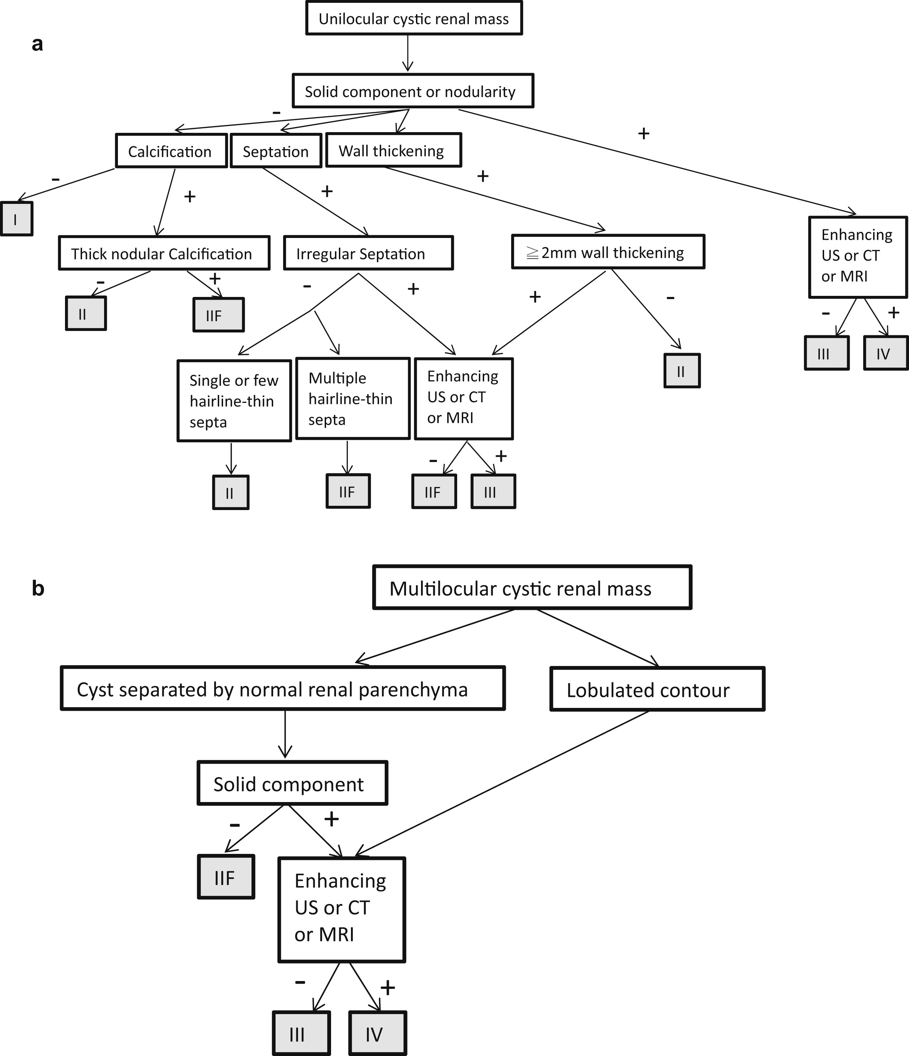

Slide 14
Hyperechoic mass
Angiomyolipoma

Slide 15
Computed Tomography
Computed tomography (CT) is still the Investigation of choice for evaluating and characterising solid renal masses.
It can accurately assess ‘pseudomasses’ and other anatomical variants and can provide attenuation values that can confirm the presence of fluid in cysts or fat in angiomyolipomas.
As CT can delineate accurately the perinephric space and the retroperitoneum
Accurate analysis of renal masses requires the use of intravenous contrast medium.
The great advantage over MRI is the rapid acquisition time.
General limitations of CT are the use of ionizing radiation and nephrotoxic iodine contrast agents.

Slide 16
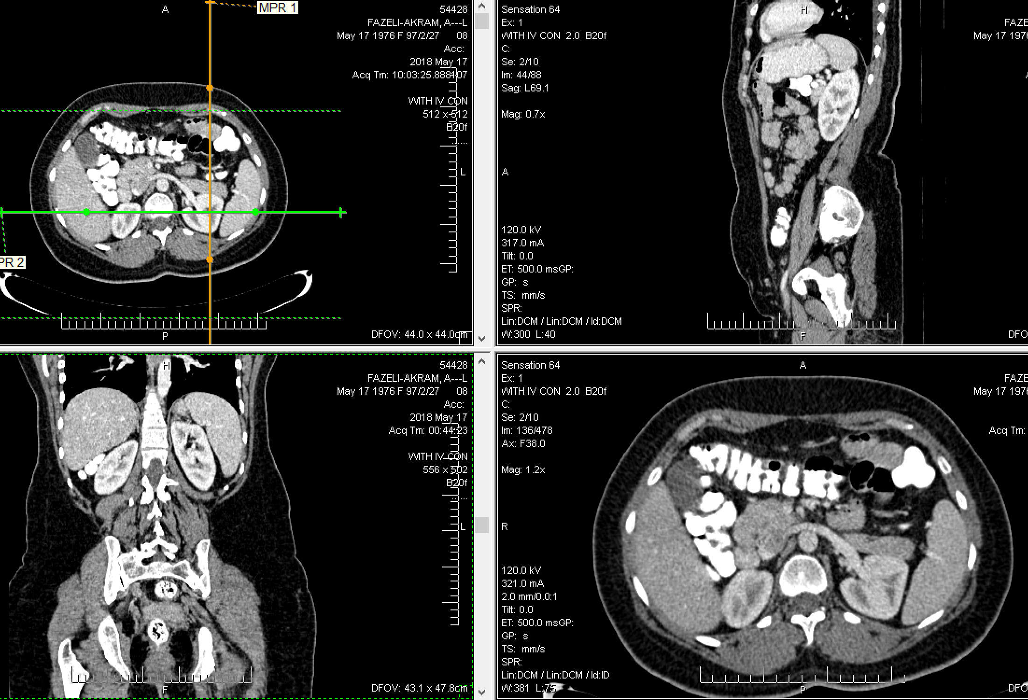
The continued development of multislice CT has improved the detection, characterisation and staging of renal tumours and allows high-quality multiplanar imaging of the kidneys, which is useful for evaluating small areas of enhancement and for presurgical planning.
With the increased use of laparoscopic and nephron-sparing surgery, it is vitally important to be able to review the coronal and sagittal images with surgical colleagues to decide upon appropriate management.

Slide 17
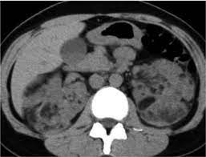
Unenhanced CT
calcification
Fat containing

Slide 18
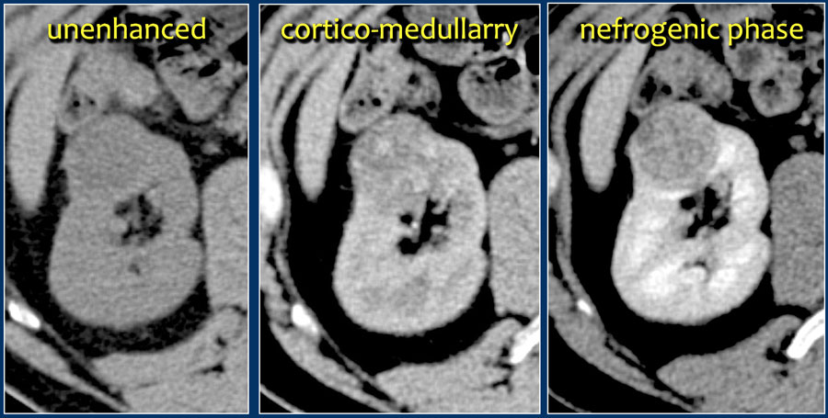
Unenhanced CT images are essential for identifying calcification and allow true evaluation of enhancement following IV contrast.
Corticomedullary phase imaging is helpful in demonstrating normal variants, pseudotumours, tumor vascularity and the renal vein.
The nephrographic phase is best for the detection of central renal masses, as the medulla is optimally enhanced and small medullary lesions are better visualized

Slide 19
A:bosniak1
B: bosniak2
C: Bosniak 2f
D:Bosniak 3
E: Bosniak 4

Slide 21
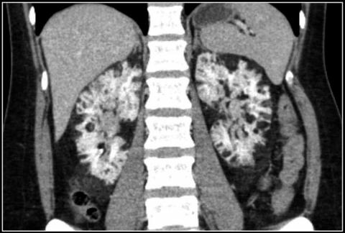
Angiomyolipoma

Slide 22
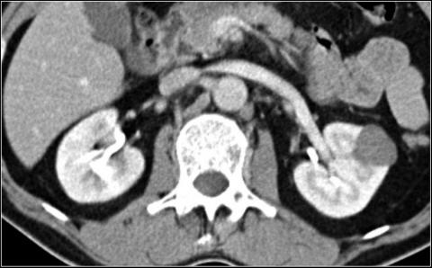
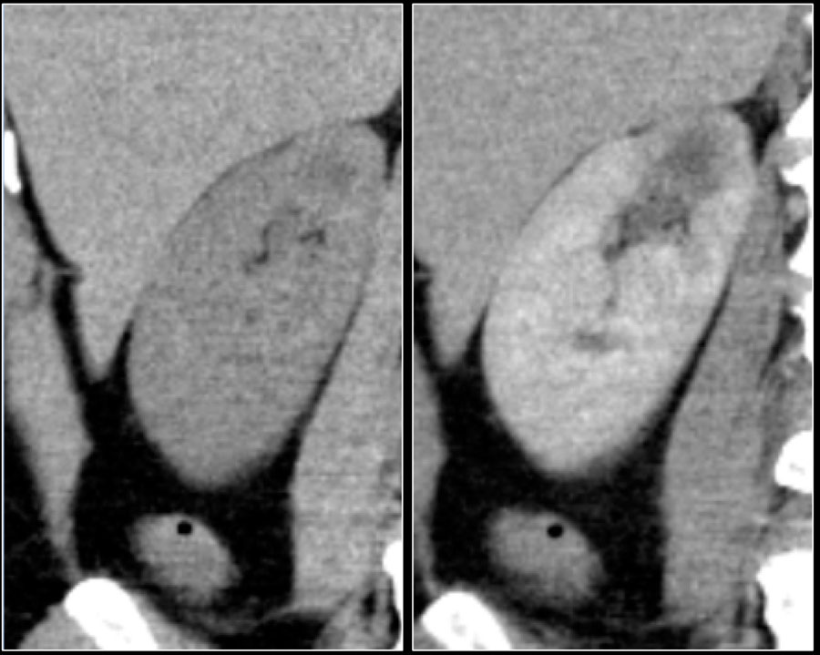
RCC

Slide 23
Extension

Slide 24
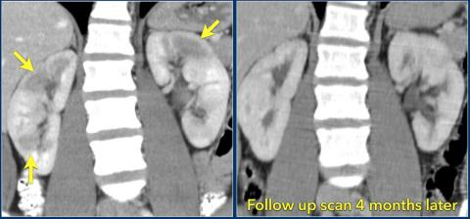
DD:
infarction
infection

Slide 25
MRI
MRI is an alternative to CT in patients with renal insufficiency or severe previous reactions to contrast medium.
MRI is superior to CT in differentiating benign thrombus from tumour thrombus and in identifying its extent.
MRI is ideally suited for monitoring patients who have a genetically increased risk of renal malignancy, such as von Hippel–Lindau disease, who require repeated imaging for surveillance.
MRI is no more specific than CT at differentiating malignant from reactive lymphadenopathy, although the development of tissue-specific agents might alter this in the future.
MRI is a more lengthy and complex investigation than CT.
The role of MRI has reduced with the development of multislice CT, which allows the production of reliable and high-quality multiplanar reconstructions.

Slide 26
Time:

Slide 29
Motion artifact

Slide 31
Angiomyolipoma

Slide 32
Thanks for attention

